Slide 1
Project-2 World University Ranking Analysis Pyspark, Spark Session, Spark Sql, Hive Context
Prepared By : Trainer:
VENKATA REDDY KOVVURI Alwyn micaiah
Venkata Naga Sri Sahithi Mulukutla
Gagan N
Yeswanth Yuppalapati

Slide 2
CONTENT
Building Spark Session
Loading the data from csv to Data Frame
Query On loaded data
Creating Global View and retrieving data from view
Creating Temporary View and retrieving data from view
Location of Temporary Viewed data stored
Stored Temporary View Queried Data
Importing Hive Context and performing query on Hive table
Using if condition checking whether the national_rank is 1 or not
Partitioning the column and displaying partitioned data
Using collect_set function to display distinct values in a column

Slide 3
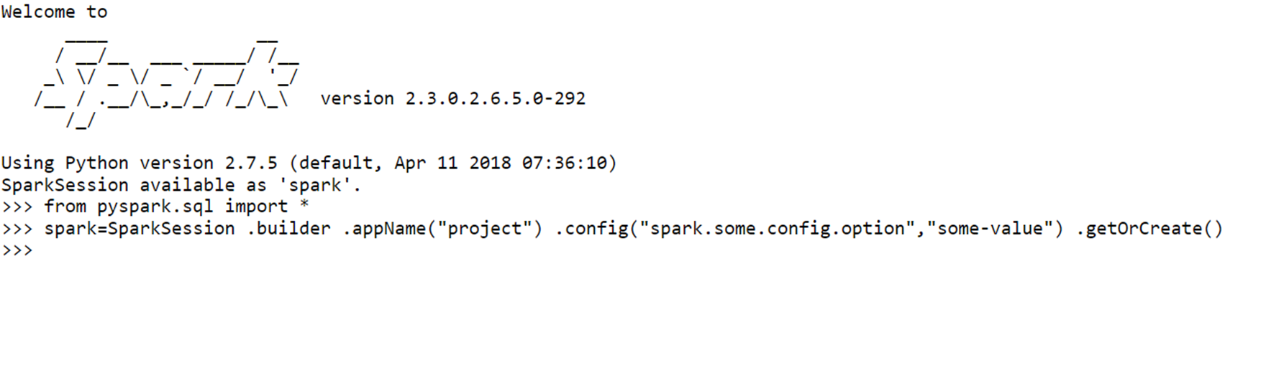
Importing packages and Building Spark Session

Slide 4
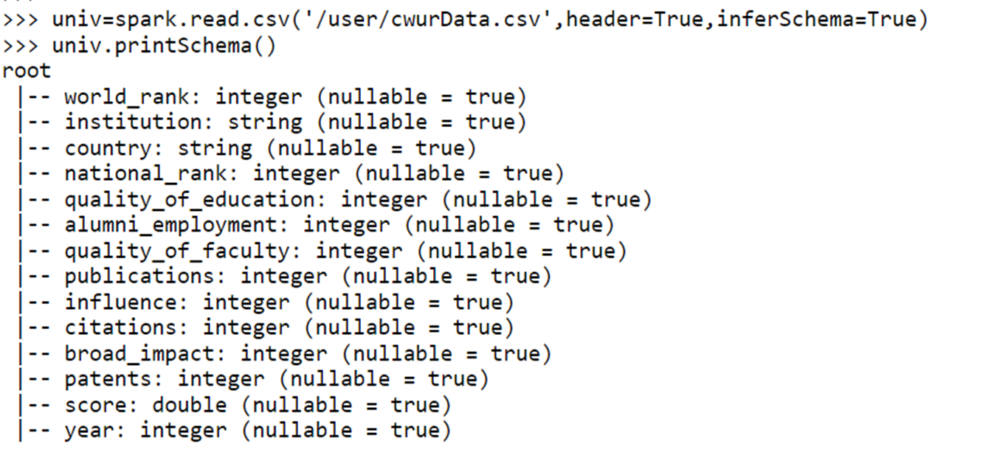
Loading the data from csv to Data Frame

Slide 5
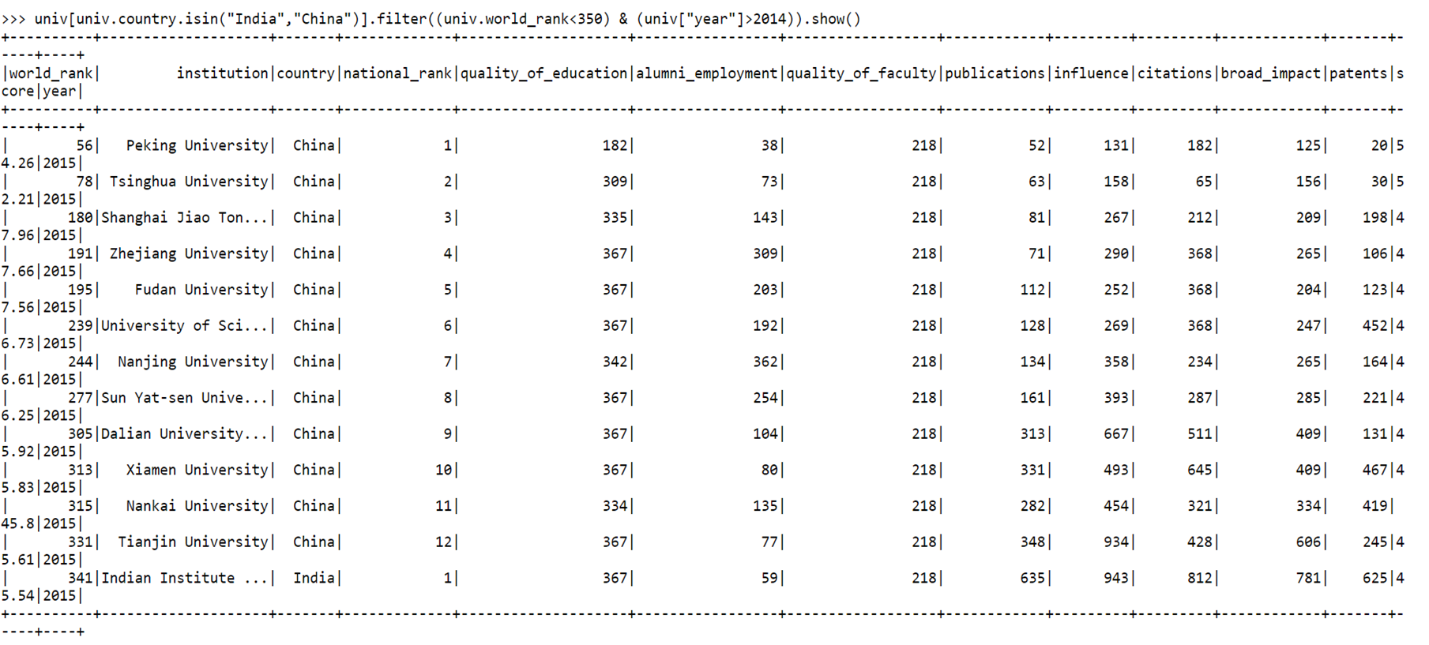
Query On loaded data showing the Data Frame of Universities in India and China with World Rank below 350 in 2014

Slide 6
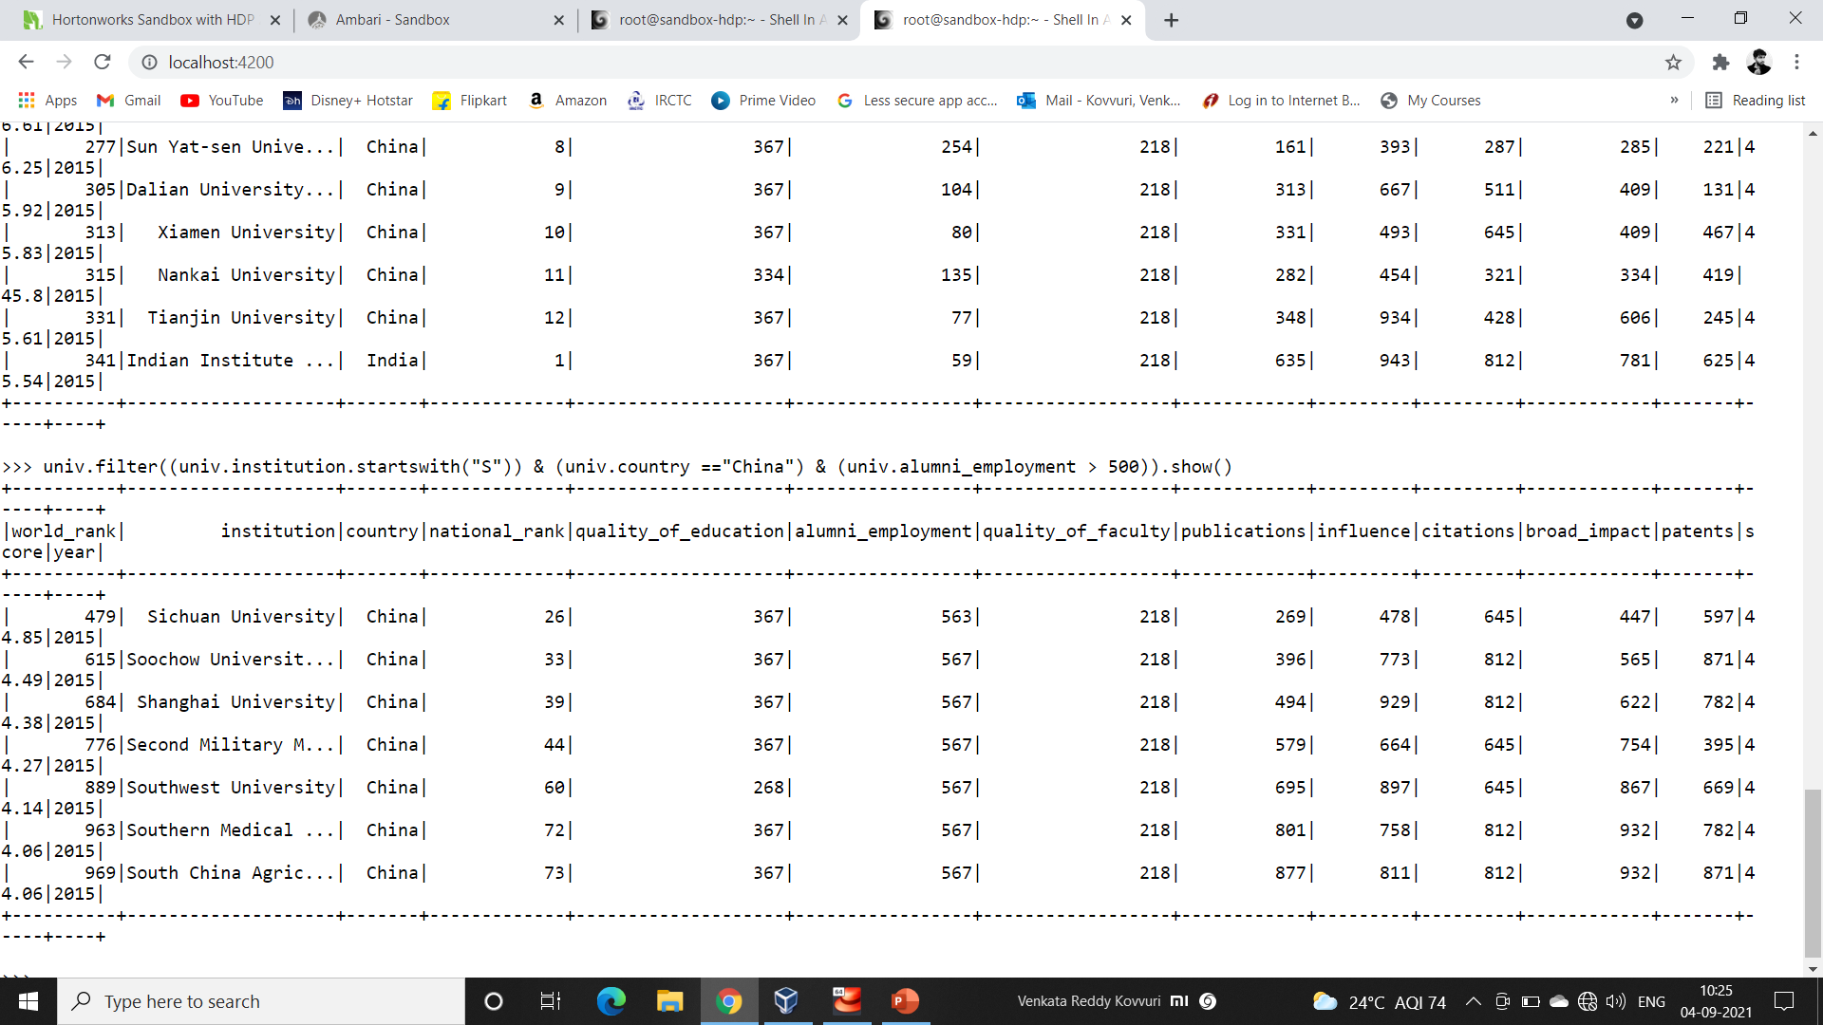
Universities in China with Name starting S having Employment above 500 Placements

Slide 7
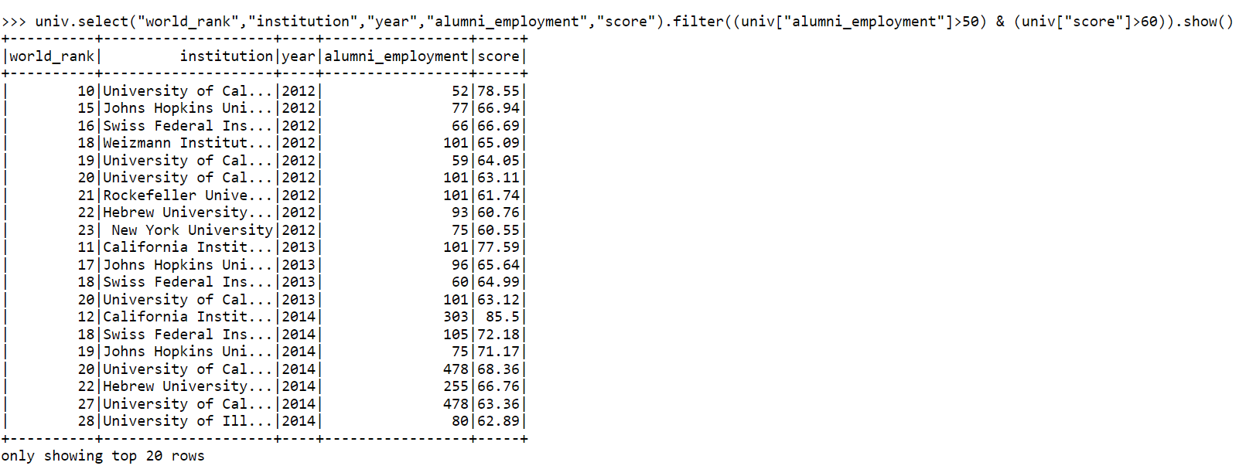
Quering the above average to top Universities having employment above fifty percentage with their World Rank

Slide 8
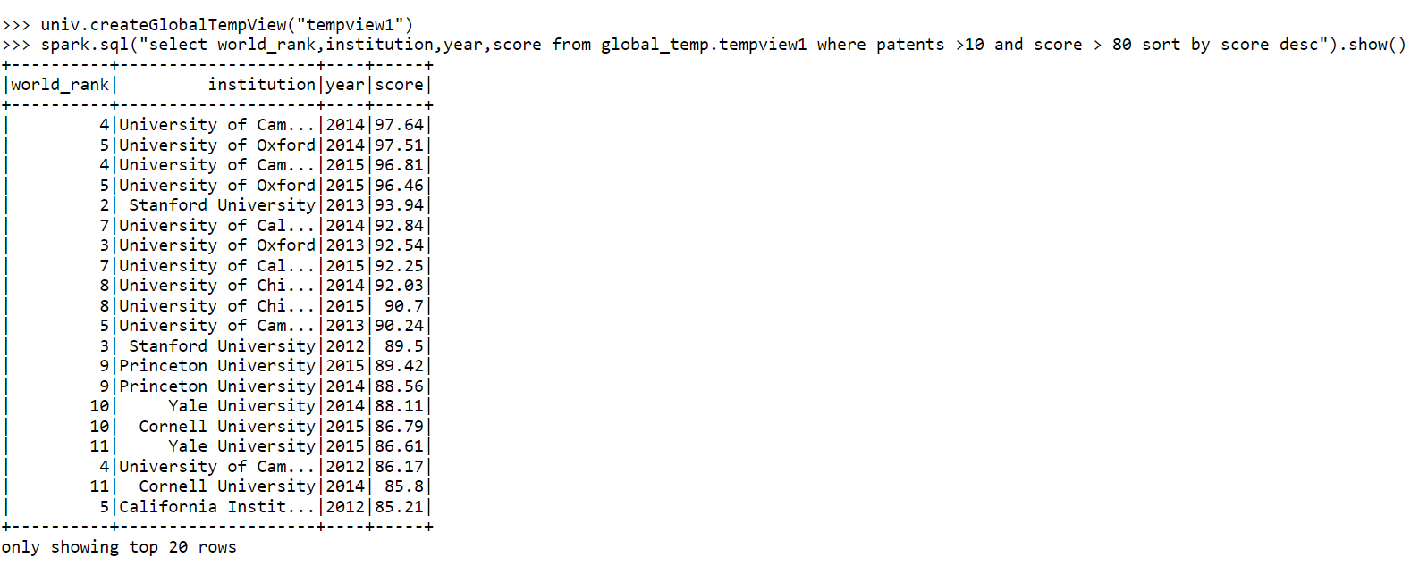
Creating Global View and retrieving data from view of Universities having patents above 10 and overall Top score above 80

Slide 9
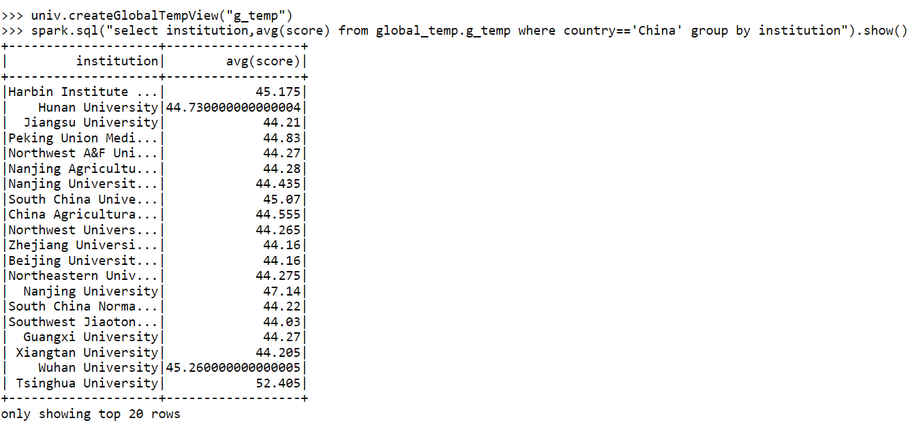
Retrieving data from global view of average score of universities in china from 2012-2015

Slide 10
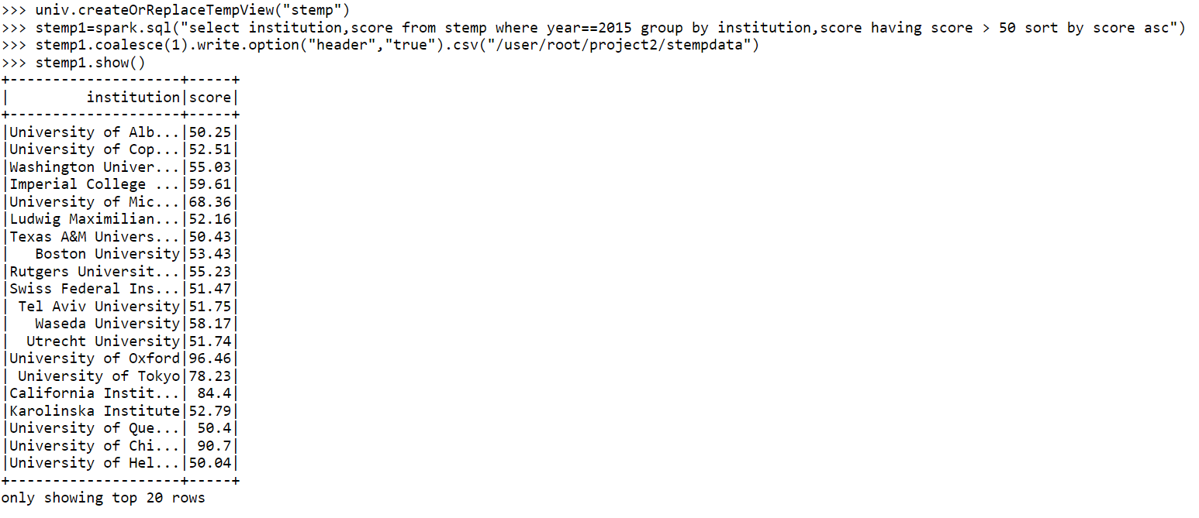
Creating Temporary View and obtaining details of scores of universities having above the fifty and Storing the Result in another file

Slide 11
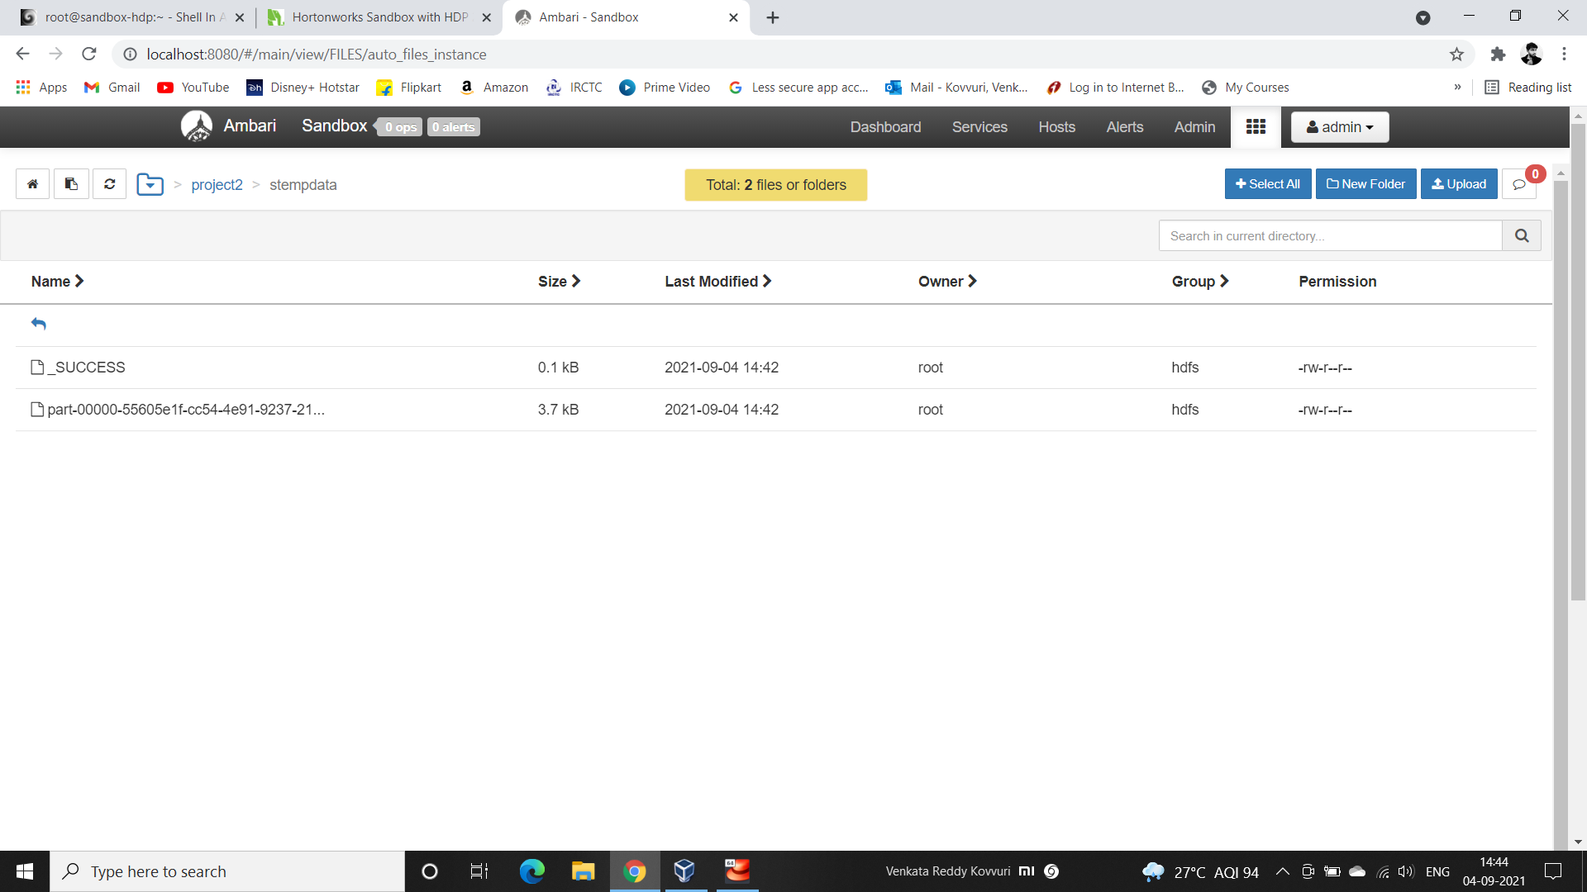
Location of Temporary Viewed data stored

Slide 12
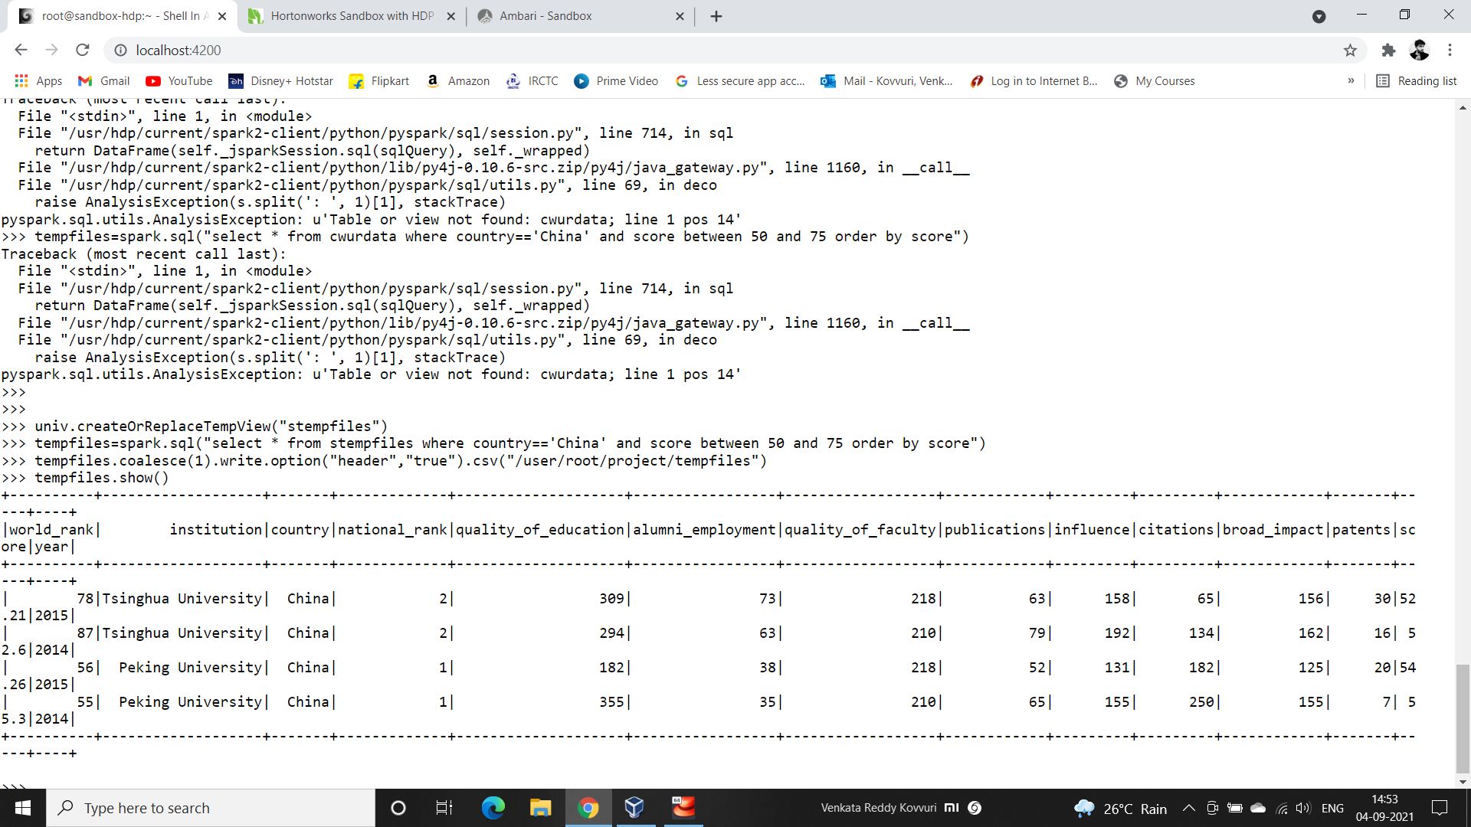
Storing the Temporary View Queried data into another file having details of universities in china which are in average score

Slide 13

Stored Temporary View Queried Data

Slide 14
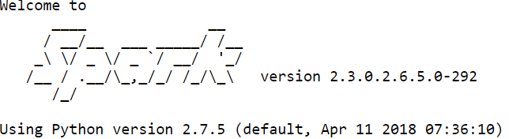
Hive Context

Slide 15
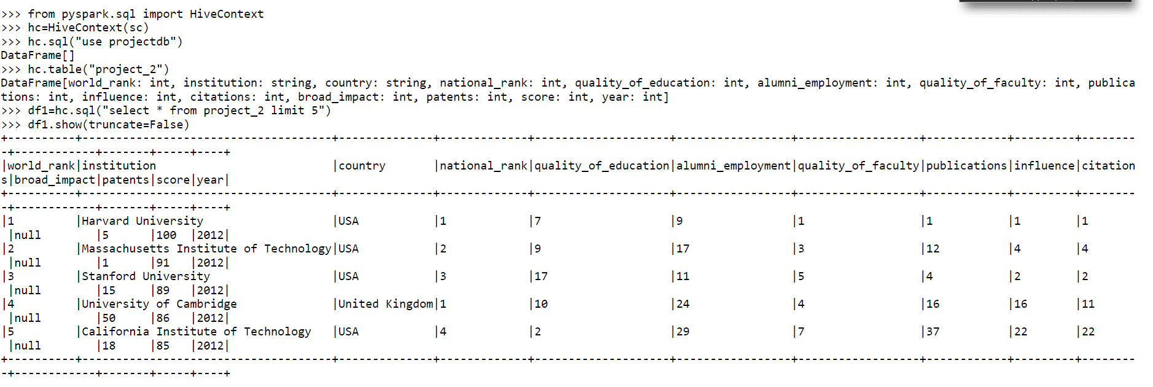
Importing Hive Context and performing query on Hive table below query is to retrieving data from the table

Slide 16
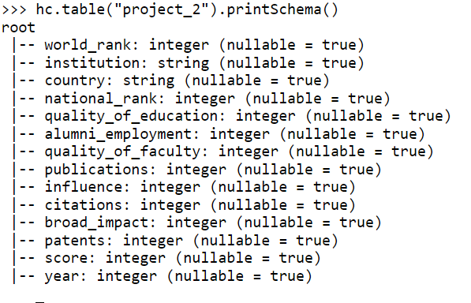
Printing schema of the table

Slide 17
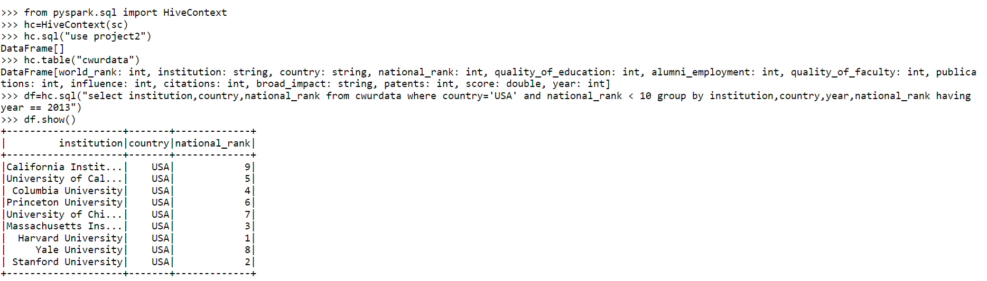
From Hive Table retrieving Universities in usa having local rank below 10 in 2013 using Hive Context

Slide 18
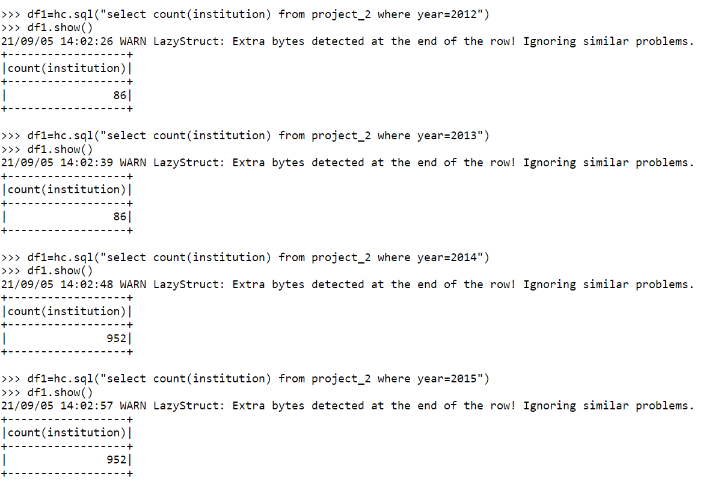
Counting institutions of years 2012, 2013, 2014, 2015

Slide 19
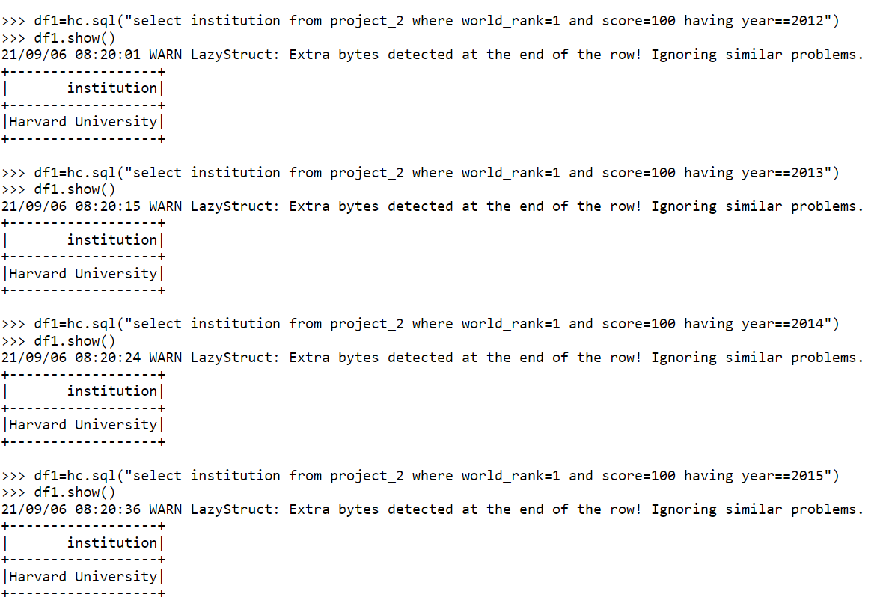
Display institution where score=100 and world_rank=1 of years 2012, 2013, 2014, 2015

Slide 20
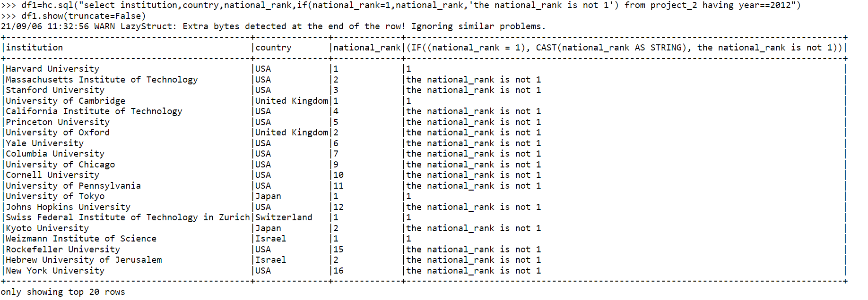
Checking whether national_rank is equal to 1 or not using if condition

Slide 21
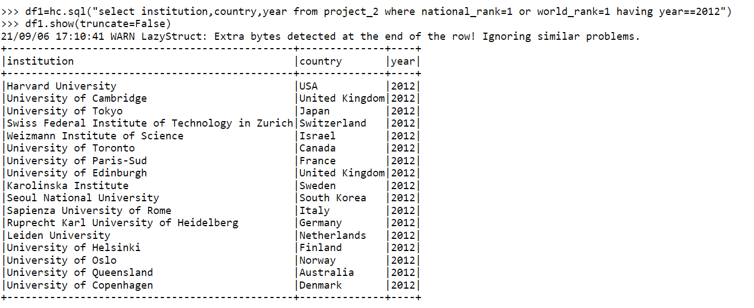
Displaying Institution, country, year where National_rank or World_rank of years 2012, 2013, 2014, 2015

Slide 22

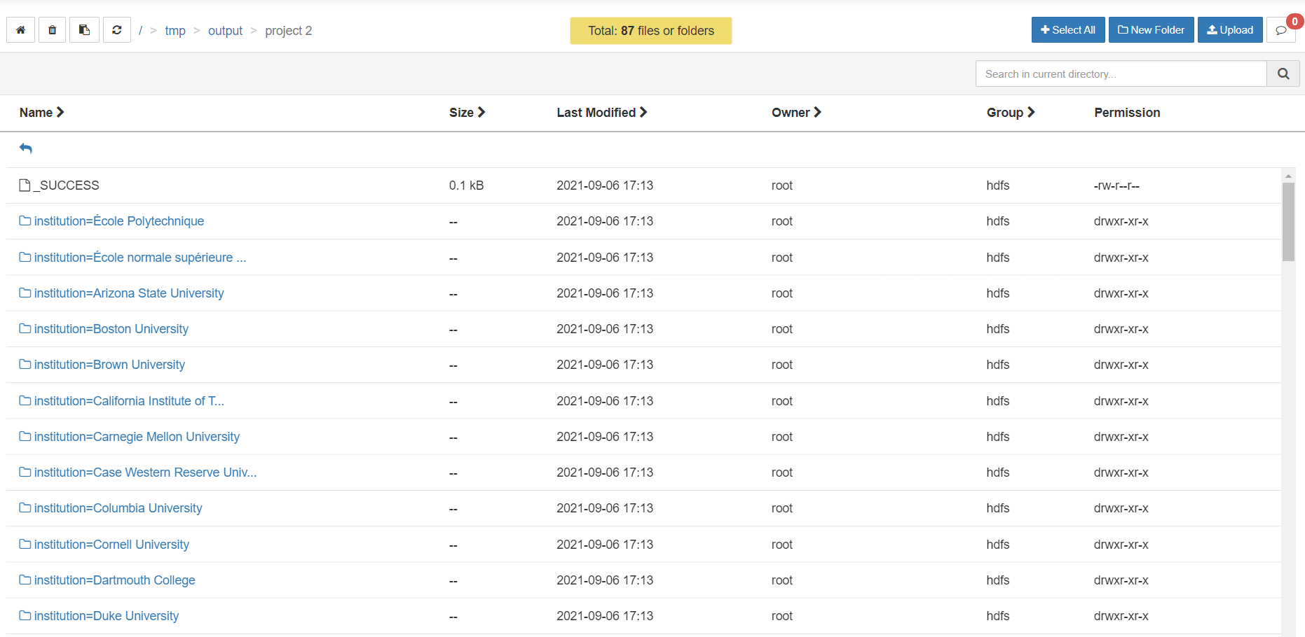
Partitioning institution
Location of Partitioned data stored

Slide 23
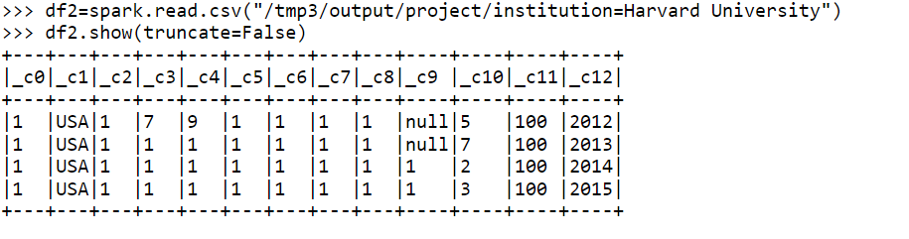
Displaying partitioned data of particular institution

Slide 24
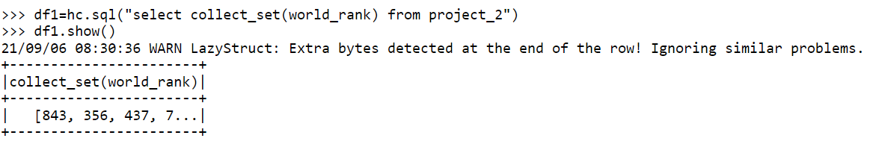
Finding distinct value in column using collect_set function

Slide 25


